Slide 1
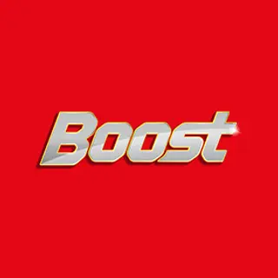
Hypothesis Test In BOOST Ad
BY
B.MARIA MANOJE

Slide 2
Advertisement from the Boost
MOTTO
Boost Secret of my energy:
Marketing Strategies And Promotions
Boost was the first health food drink brand in India that used sports celebrities to endorse its benefits to the public. Its association with the sports of cricket is of particular interest here.
The superstars of the game like Kapil Dev, Sachin Tendulkar, Virendra Shewag, Mahendra Singh Dhoni and Virat Kohli have promoted the brand during their playing careers. Currently, M. S. Dhoni and Virat kohli can be seen regularly in the various media platforms endorsing the value of consuming Boost to the public.

Slide 3
DATA
WE TAKE TWO AGE GROUPS:
YEAR AGE BETWEEN 05-15 AGE BETWEEN 16-25
2018 30 75
2019 40 70
2020 10 25
2021 50 70
2022 22 80

Slide 4
Hypothesis
Hypothesis for an with age between 05-15 and age between 16-25
p=0.028451
which is less than 0.05 that is alpha
EXCEL FILE:
C:\Users\Mano\Documents\imarticus\boost.xlsx

Slide 5
BAR CHART FOR SALES

Slide 6
Conclusion
Boost has proven its market credibility in the highly competitive Indian HFD market where there is a plethora of choice available for the consumers. With independent scientific data available to back up its claims of providing more stamina and adequate all-round nutrition to its target segment of youngster between 16 to 25, the health food drink is a sure choice of many satisfied sports person for the last five decades of its existence.

